Slide 1


K. RAMAKRISHNAN COLLEGE OF ENGINEERING
(AUTONOMOUS), SAMAYAPURAM – TRICHY
DEPARTMENT OF ARTIFICIAL INTELLIGENCE MACHINE LEARNING
AMB1221 MACHINE LEARNING AND FUNDAMENTALS
Cyberbullying Risk Prediction Using Machine Learning
PRESENTED BY SUPERVISOR
ARCHANA RS Mrs. C.Muthuselvi , M.E.,
8115U24AM008 Assistant Professor / AI&DS.

Slide 2
PRESENTATION OVERVIEW
Project Introduction
Objective
Problem Statement
Software and Hardware used
Existing and Proposed Comparision
Modules Used
Architecture Diagram
Output Screenshots
Conclusion and Future Scope
References

Slide 3
PROJECT INTRODUCTION
Cyberbullying is harassment through online platforms.
It affects users emotionally and mentally.
Manual detection of harmful messages is difficult.
Machine Learning helps detect bullying automatically.

Slide 4
OBJECTIVE
Detect cyberbullying in online text messages.
Build a Machine Learning prediction model.
Analyze text using NLP techniques.
Improve online safety.

Slide 5
PROBLEM STATEMENT
Large amount of online messages makes monitoring difficult.
Cyberbullying causes serious mental health issues.
Need an automated system to detect harmful content.

Slide 6
SOFTWARE AND HARDWARE USED
SOFTWARE USED | HARDWARE REQUIRED
Jupyter Notebook / Google Colab | Intel i3 or above
Pandas, NumPy, Scikit-learn | 4 GB RAM
Matplotlib / Seaborn | Windows / Linux OS
Scikit learn | SSD for faster model training

Slide 7
EXISTING AND PROPOSED COMPARISION
Existing syatem:
Manual monitoring
Slow and less accurate
Proposed system:
Machine Learning based detection
Faster and more accurate

Slide 8
MODULES USED
Data Collection
Data Preprocessing
Feature Extraction
Model Training
Prediction
Visualization

Slide 9
MODULE 1 & 2
Data Collection Module:
Collects dataset containing online comments or messages.
Data can be taken from social media datasets or Kaggle.
Used as the input for training the model.
2. Data Preprocessing Module:
Removes stop words, punctuation, and unwanted characters.
Converts text into clean and usable format.
Improves the accuracy of the machine learning model.

Slide 10
MODULE 3 & 4
3. Feature Extraction Module:
Converts text data into numerical form.
Uses techniques like Bag of Words or TF-IDF.
Helps the machine learning model understand the text data.
4. Machine Learning Model Module:
Trains the model using classification algorithms.
Algorithms like Naive Bayes, Logistic Regression, or SVM are used.
The model learns to identify bullying patterns.

Slide 11
MODULE 5 & 6
5. Prediction Module
Takes new user text input.
The trained model analyzes and classifies the message.
Predicts whether the message is Cyberbullying or Not.
6. Visualization Module
Displays graphs and charts for analysis.
Shows dataset distribution and model accuracy.
Helps in better understanding of results.

Slide 12
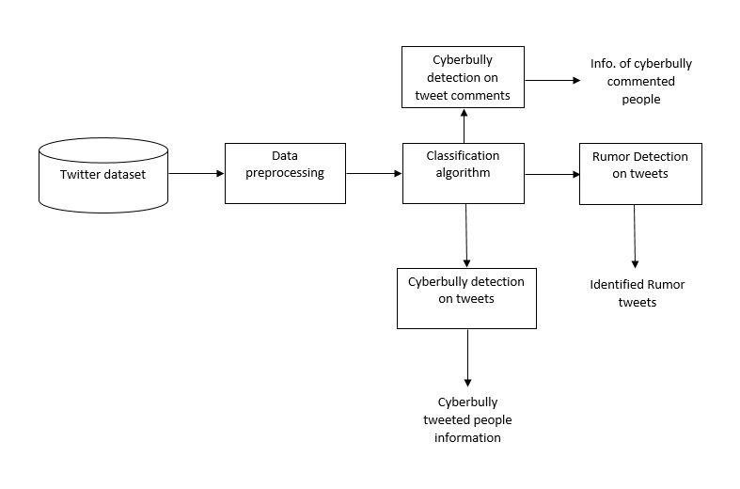
ARCHITECTURE DIAGRAM

Slide 13
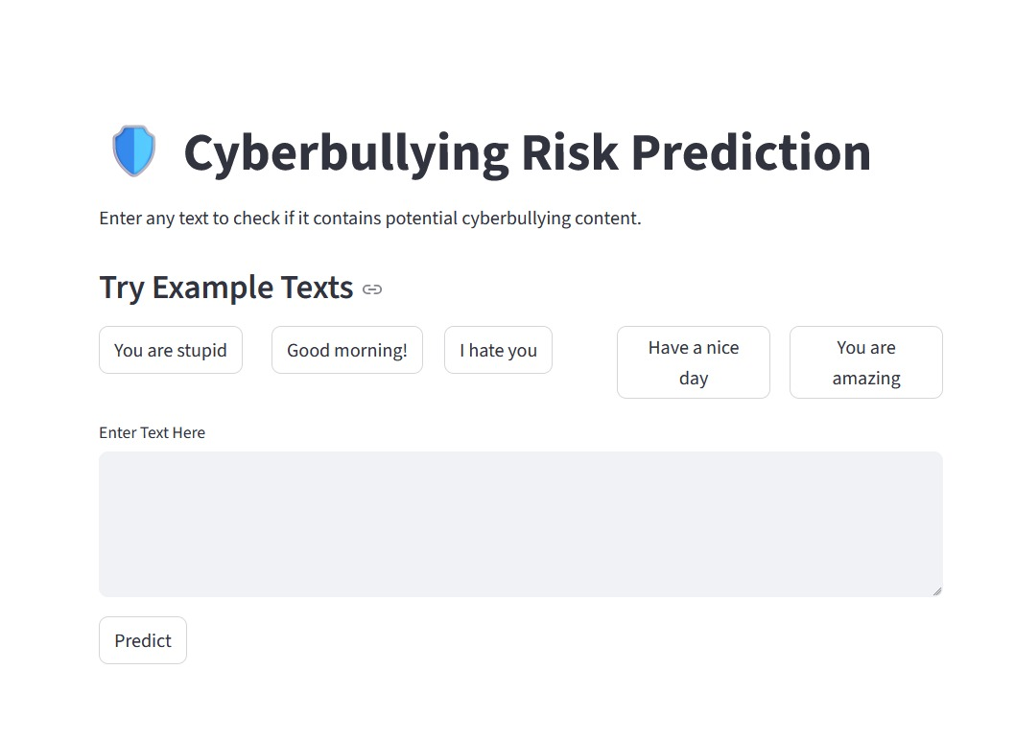
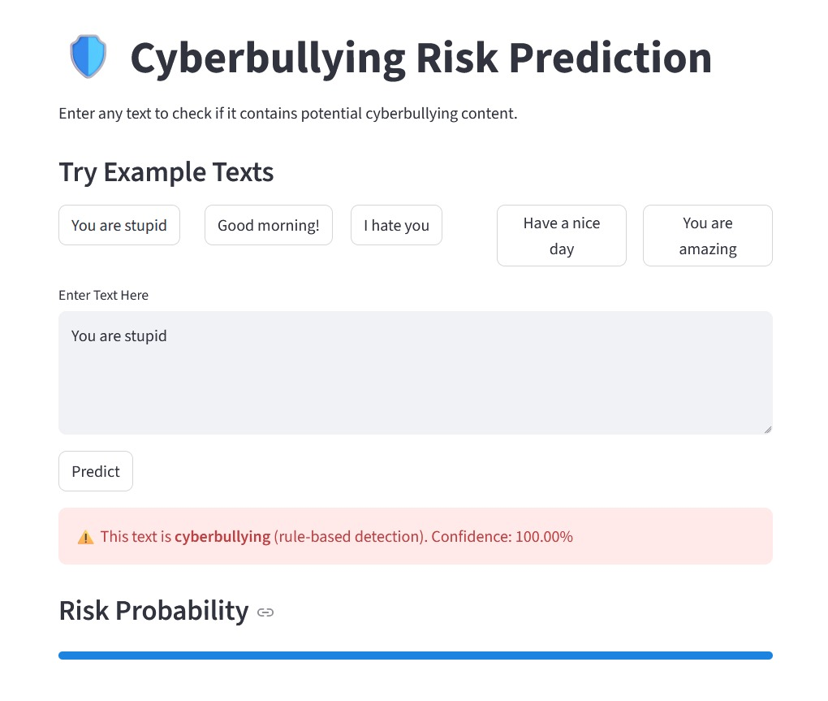
OUTPUT SCREENSHOTS

Slide 14
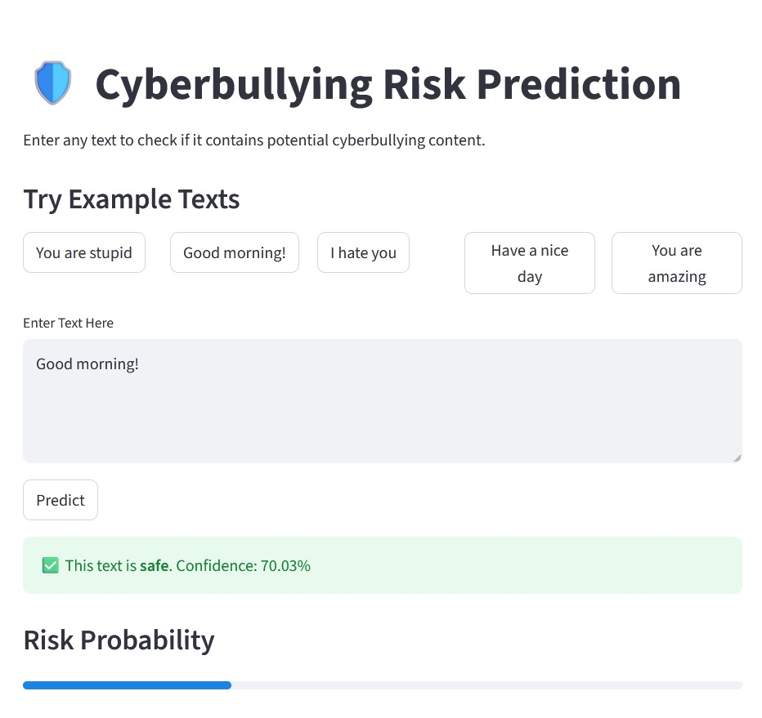
OUTPUT SCREENSHOT

Slide 15
CONCLUSION
ML helps detect cyberbullying automatically.
Improves safety on online platforms.
Machine Learning helps automatically detect cyberbullying messages.
The system can analyze large amounts of online text quickly.
It helps reduce harmful content on social media platforms.
Early detection can protect users from emotional and mental stress.

Slide 16
FUTURE SCOPE
Real-time detection on social media.
Use Deep Learning models.
Support multiple languages.
Improve accuracy using Deep Learning models.
Support multiple languages for better detection.
Develop a mobile or web application for users.
Integrate with social media monitoring systems.

Slide 17
REFERENCES
Research papers on Cyberbullying Detection
Python Documentation
Scikit-learn Documentation
Kaggle Dataset

Slide 18


